Slide 1
Solutions of Differential Equation by Classical Approach
Compiled By:
Asst. Prof. Uddhav Bhattarai
Cosmos College of Management and Technology

Slide 2
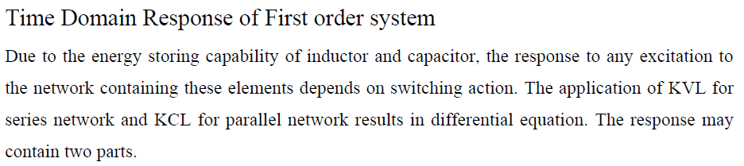
Classical Approach of obtaining total solution/response

Slide 3
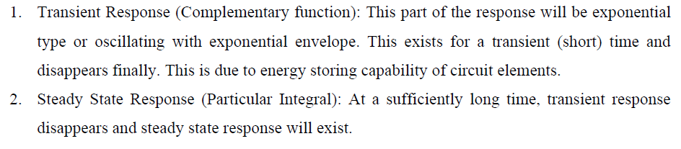
Classical Approach of obtaining total solution/response

Slide 4
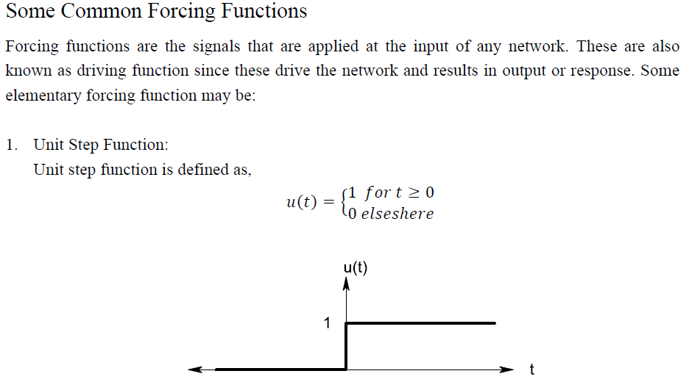
Classical Approach of obtaining total solution/response

Slide 5
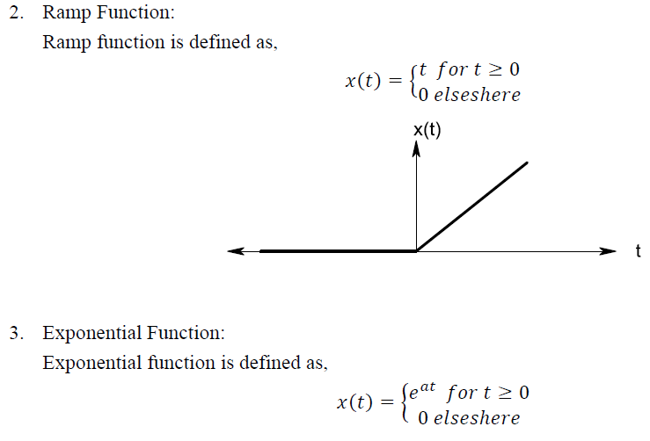
Classical Approach of obtaining total solution/response

Slide 6
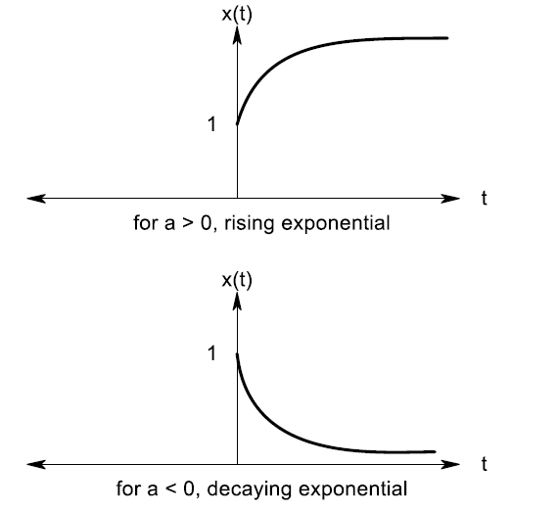
Classical Approach of obtaining total solution/response

Slide 7
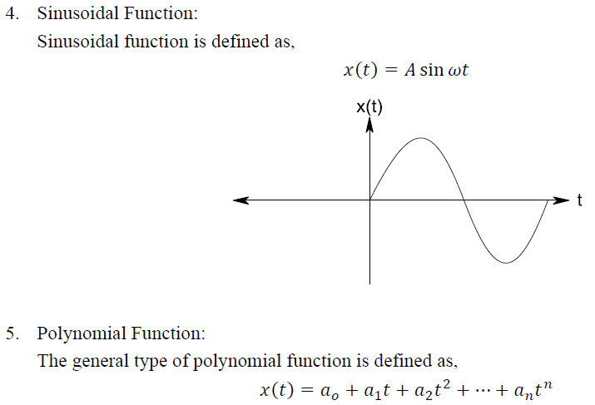
Classical Approach of obtaining total solution/response

Slide 8
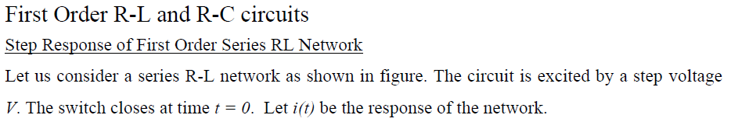
Classical Approach of obtaining total solution/response

Slide 9
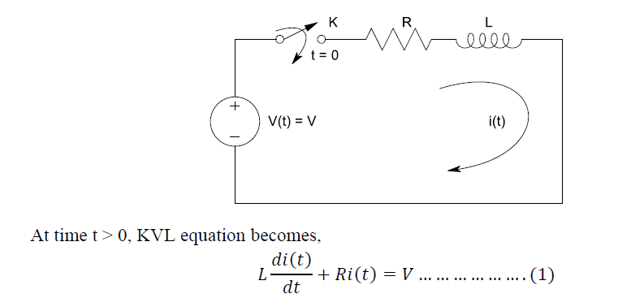
Classical Approach of obtaining total solution/response

Slide 10
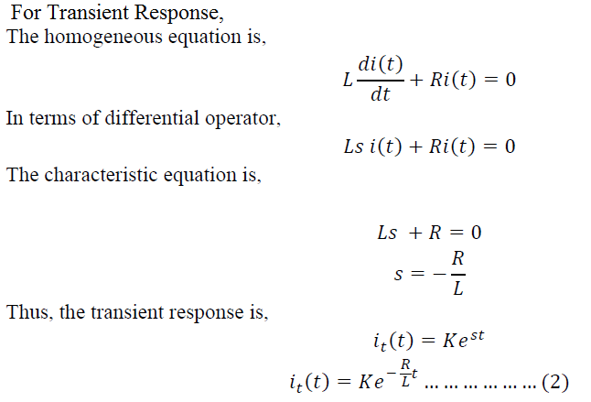
Classical Approach of obtaining total solution/response

Slide 11
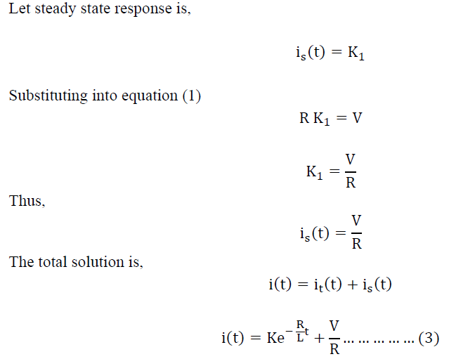
Classical Approach of obtaining total solution/response

Slide 12
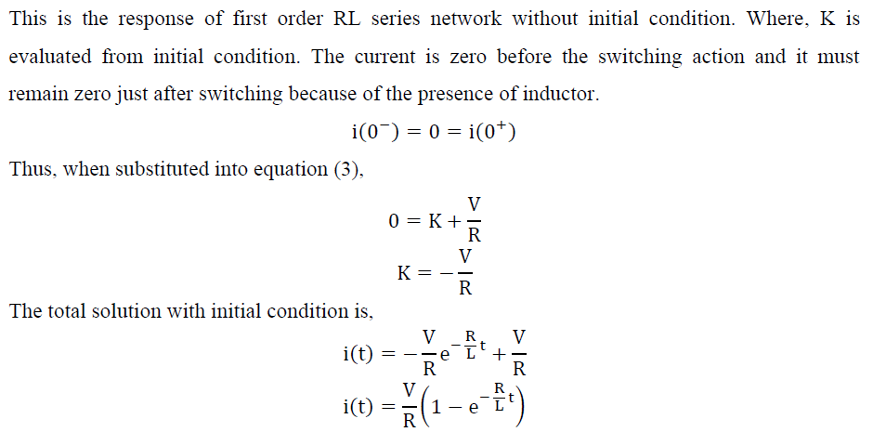
Classical Approach of obtaining total solution/response

Slide 13
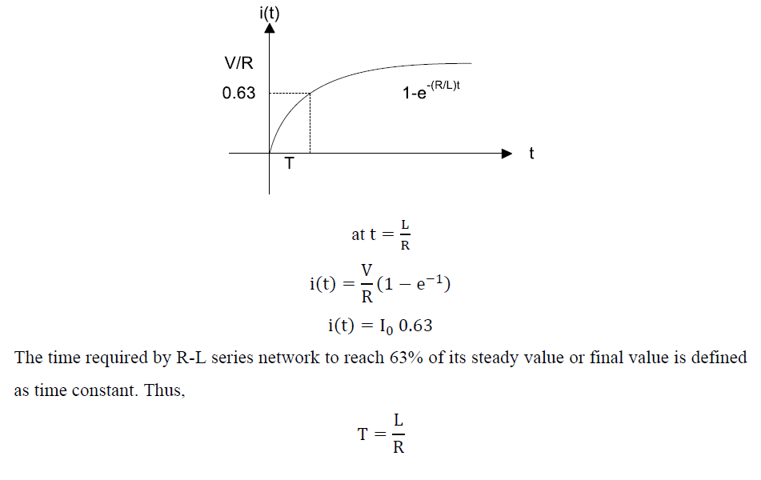
Classical Approach of obtaining total solution/response

Slide 14
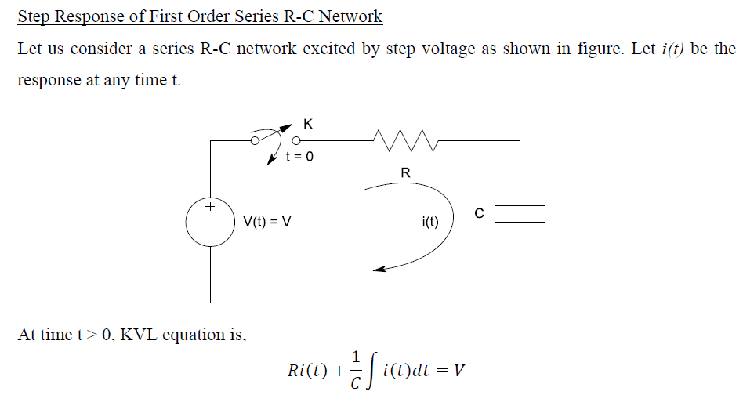
Classical Approach of obtaining total solution/response

Slide 15
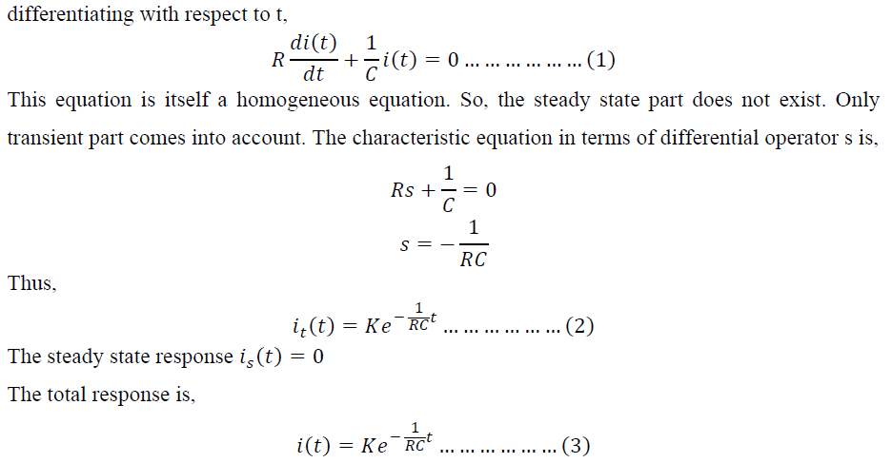
Classical Approach of obtaining total solution/response

Slide 16
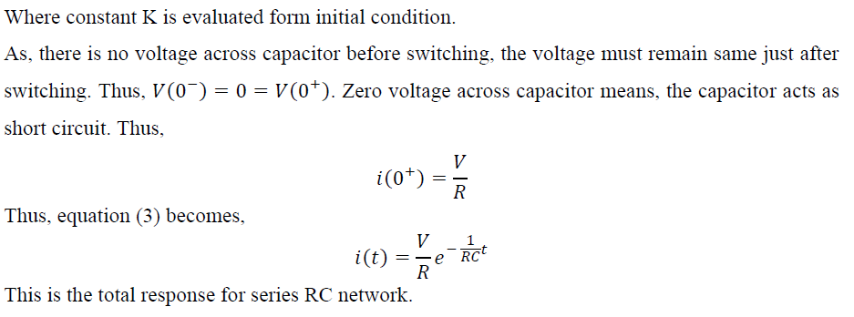
Classical Approach of obtaining total solution/response

Slide 17
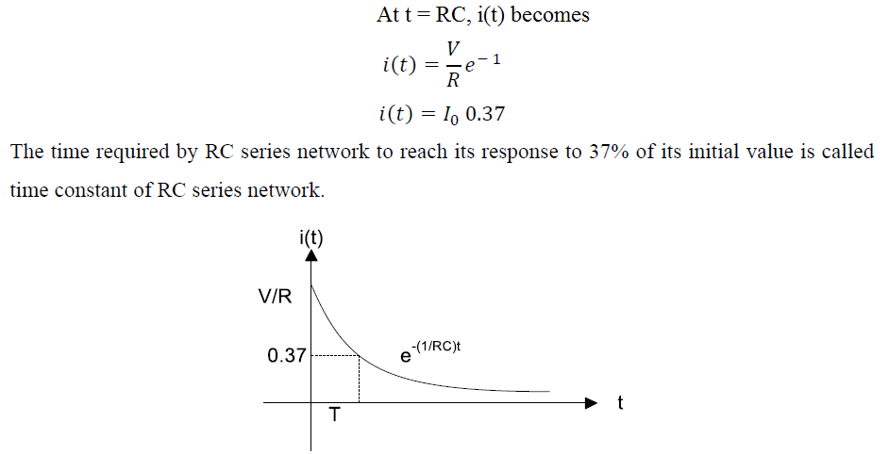
Classical Approach of obtaining total solution/response

Slide 18
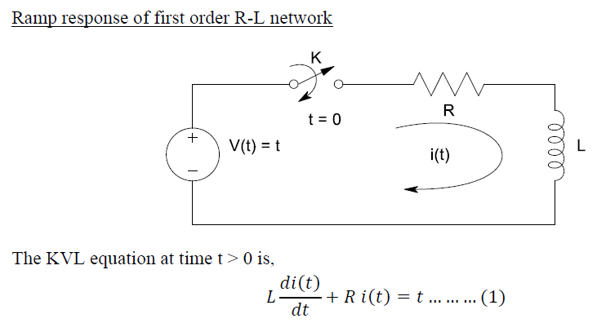
Classical Approach of obtaining total solution/response

Slide 19
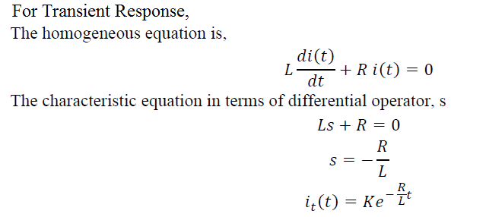
Classical Approach of obtaining total solution/response

Slide 20
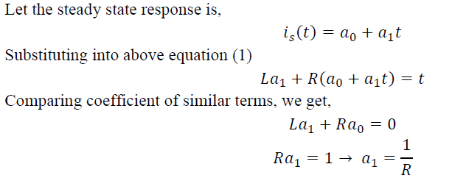
Classical Approach of obtaining total solution/response

Slide 21
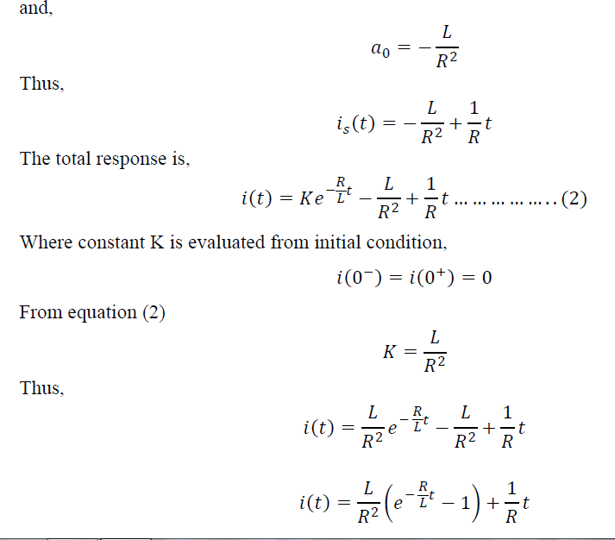
Classical Approach of obtaining total solution/response

Slide 22
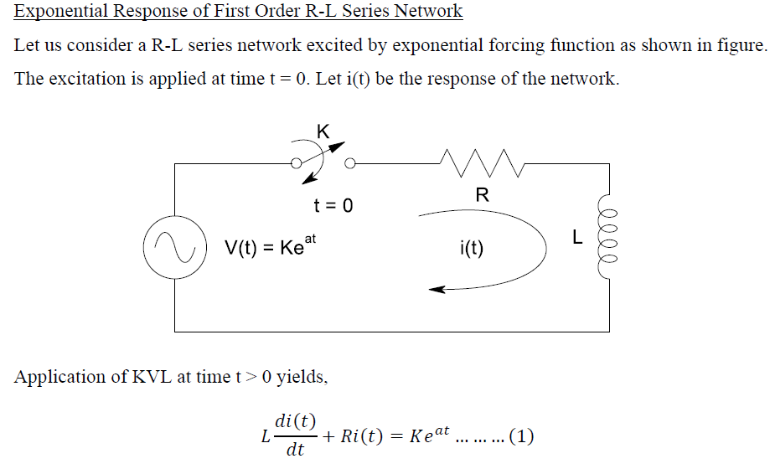
Classical Approach of obtaining total solution/response

Slide 23
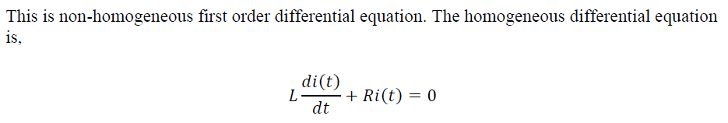
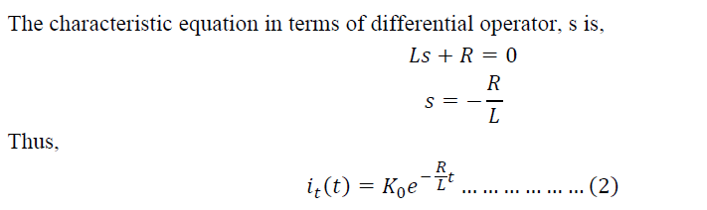
Classical Approach of obtaining total solution/response

Slide 24
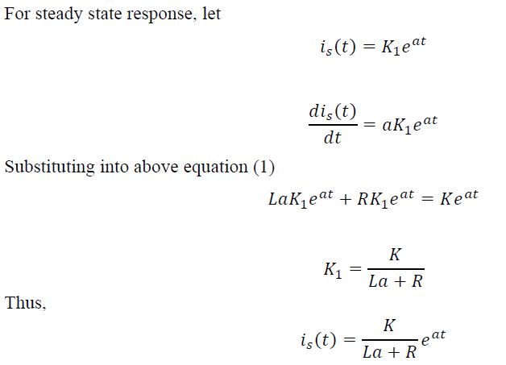
Classical Approach of obtaining total solution/response

Slide 25
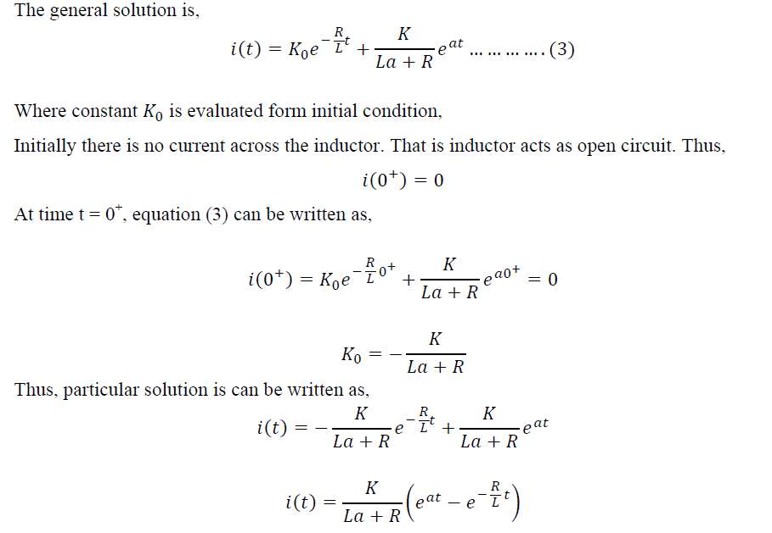
Classical Approach of obtaining total solution/response

Slide 26
Classical Approach of obtaining total solution/response
Complete Response of first order R - L and
R -C Series Circuit to Sinusoidal Input
Next class……………….
Thank You!!!

